Slide 1
Representing
Data Elements
Bogdan Dumitriu
November 24th, 2004

Slide 2
Summary
Representing data elements
  Data elements and fields
  Records
  Representing block and record addresses
  Variable-length data and records
  Record modifications
Index on sequential files

Slide 3
Topics
Representing data elements
  Data elements and fields
  Records
  Representing block and record addresses
  Variable-length data and records
  Record modifications
Index on sequential files

Slide 4
CHAR vs. VARCHAR
Note: L – actual length of stored string

Slide 5
CHAR vs. VARCHAR
space usage – use VARCHAR
fast search/sort – use ?
better management – use CHAR
minimize corruption – use CHAR
comparison semantics – varies
tip: if n < 4 always use CHAR

Slide 6
BIT [VARYING]
bit logical operators (&, |, <<, etc.)
additional type checking
allows more efficient storage:
b'11010011'
0
7
'11010011'
0
7

Slide 7
Topics
Representing data elements
  Data elements and fields
  Records
  Representing block and record addresses
  Variable-length data and records
  Record modifications
Index on sequential files

Slide 8
Data alignment
instruction word
...
01110110...11
...
32 bits
1011001...01
(32 bits)
+0 +3
32
...0h
...4h
<
10110...0100
(34 bits)

Slide 9
Record schema
Reasons for record schema
  accomodates schema changes
  more types of records in same block
    that's why we need r.s. pointer in record

Slide 10
Block size
File system based data files
  direct I/O
  buffered I/O
Raw I/O data files

Slide 11
Buffered I/O
Main memory
DB cache
FS cache
Disk

Slide 12
Buffered I/O
use FS buffer size = DB block size
DB
DB
OS
OS
Disk
Disk
partial block writes
I/O fragmentation

Slide 13
Direct/raw I/O
Allows a wider selection of block sizes
Decision based on
  size of records
  type of database/table access
  many others
General tendency: increase block size

Slide 14
Small block size
good for small rows
good for non-sequential access
reduces block contention
large space overhead
bad for large rows

Slide 15
Large block size
good for large rows (reduces chaining)
good for sequential access
wastes buffer cache
increased block contention
  bad for indexes

Slide 16
Topics
Representing data elements
  Data elements and fields
  Records
  Representing block and record addresses
  Variable-length data and records
  Record modifications
Index on sequential files

Slide 17
DB Addresses
Physical address
  no translation
  longer
Logical address
  translation needed (using map table)
  shorter
  allows flexibility

Slide 18
Structured addresses
Disadvantages of offset tables
  waste of space (4KB block => 10 bits/rec)
  additional level of indirection
Header format
  depends on addressing scheme
  key-based – just use a count
  offset table – just use the offset table
  ...

Slide 19
Pointer swizzling
Disk
Main memory
1
...
F1 EA 45 AB 3A 41 0B 55
...
...
1 F1 EA 45 AB 3A 41 0B 55
...

Slide 20
Pointer swizzling
Disk
Main memory
1B 22 13 4C
1
...
F1 EA 45 AB 3A 41 0B 55
...
0
...
1B 22 13 4C
...
Translation table
F1EA45AB3A410B55 1B22134C

Slide 21
Swizzling techniques
Automatic
  block -> memory
  all addressable items -> transl. table
  swizzle all possible pointers in block on load
On demand
  block -> memory
  all addressable items -> transl. table
  swizzle pointers in block on demand

Slide 22
Swizzling
Efficiency depends on app. profile
  follow most pointers => use automatic
  follow just a few pointers => use on demand
  adaptable swizzling
Why swizzle?
  no swizzling => use TT every time
  swizzling => use TT once (maybe twice)

Slide 23
Swizzling
Virtual memory approach
  easier management
  (very) expensive
  enhancement: swizzle all pointers in block
  enhancement: persist swizzled pointers
''Software'' approach
  more difficult management
  less costly

Slide 24
Unswizzling
Ensuring pointer correspondence
  no change – address stays the same
  changes in records
    unswizzle all pointers
    use indirect swizzling
Efficient unswizzling
  use a hash table
  use an index or linked list

Slide 25
Topics
Representing data elements
  Data elements and fields
  Records
  Representing block and record addresses
  Variable-length data and records
  Record modifications
Index on sequential files

Slide 26
NULLs
record length
other header
info
to address
gender
birthdate
name
address
Use info on...
  fixed length part of record
  first non-NULL pointer
  record length
...or just add a pointer for name field

Slide 27
Efficiency
Variable-length fields
  are always less efficient
  sometimes save space
Only solution
  use fixed-length fields

Slide 28
Tagged fields
Useful in relational DBs:
  information-integration apps
  records with flexible schema
  main reason: save space

Slide 29
Why use BLOBs?
performance is not the only issue!
may need ACID properties
may need portability
may need access rights
easier management
may even want to index BLOB field
performance might not be affected

Slide 30
Why use files?
could be more efficient
BLOBs can make DB's huge
easier manipulation of data
allows caching (with web pages)

Slide 31
Topics
Representing data elements
  Data elements and fields
  Records
  Representing block and record addresses
  Variable-length data and records
  Record modifications
Index on sequential files

Slide 32
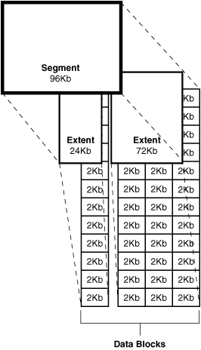
Free space mgmt.
Oracle logical units:
block
- smallest unit that
can be used
extent
- contiguos blocks
segment
- (non-)contiguous
extents

Slide 33
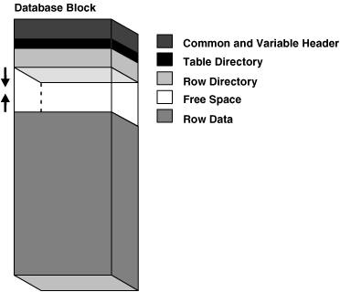
Free space mgmt.
DELETE's & UPDATE's free space
free space compressed only when needed

Slide 34
Free space mgmt.
row too large to fit in one block => row chaining
row is updated, block is already full => row migration
I/O performance decreases

Slide 35
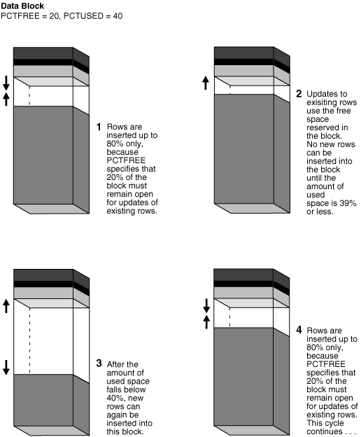
Free space mgmt.

Slide 36
Free space mgmt.
Find space on ''nearby'' block
  could ''save the day'' in some cases
  cannot be used alone
Create an overflow block
  easier to index
  problems during retrieval
Solution: page (block) split

Slide 37
Tombstones
Tombstones vs. NULL
  tombstone is just a marker
  NULL is a marker as well
  conclusion: they are equivalent

Slide 38
Topics
Representing data elements
  Data elements and fields
  Records
  Representing block and record addresses
  Variable-length data and records
  Record modifications
Index on sequential files

Slide 39
Dense/sparse indexes
10
10
10
20
20
30
30
30
50
40
40
70
50
50
90
60
60
110
70
130
80
70
150
80
90
170
100
90
190
110
100
210
120
230

Slide 40
Example 4.8
10
10
20
10
30
10
30
20
40
20
etc.
30
30
30
40
50

Slide 41
Managing sparse ind.
Insert record
  if key is smallest, update
  else, leave unchanged
Delete record
  if smallest key deleted, update
  else, leave unchanges
Slide record
  if smallest key in either block changes, up.

Slide 42
Conclusions
None really, except that 36h is way too little time for 31 questions...
Any questions (submitted or not) left unanswered?

